Slide 1
MANAGEMENT INFORMATION SYSTEM
MEHTAP PARLAK
2008503098
Industrial Engineering Department, Dokuz Eylul University, Turkey

Slide 2
Content
An introduction to Information System
Meaning of Management Information System
Characteristic of MIS
Components of MIS
The aim of MIS
Types of MIS
Outputs of MIS
Benefits of MIS

Slide 3
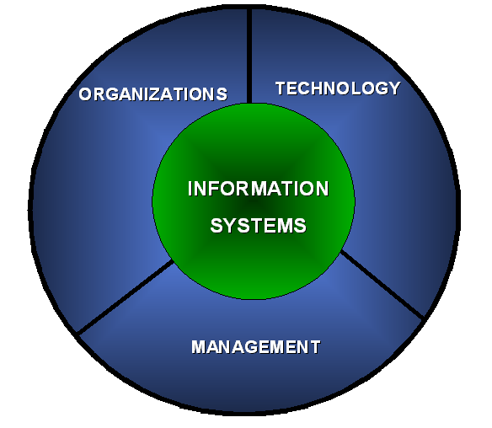

Meaning Of Information Systems
An information system is an organized combination of people, hardware, software, communications Networks and data resources that collects, transforms, and disseminates information in an organization.

Slide 4
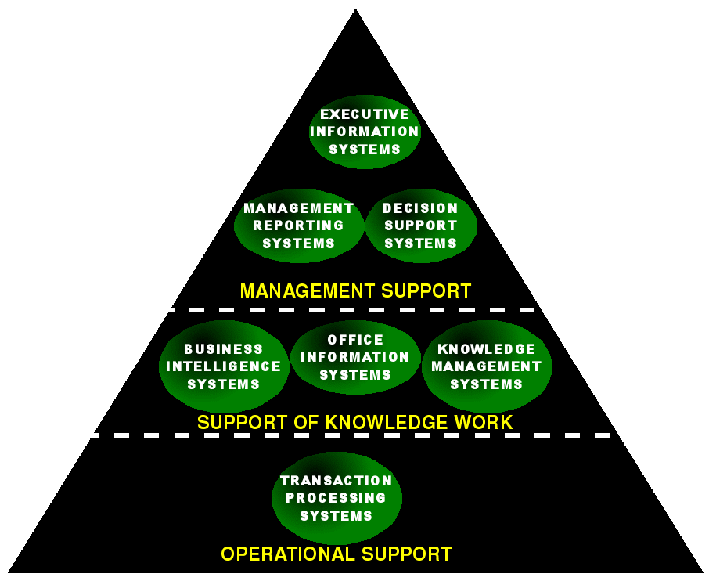
Types Of Information System

Slide 5

MANAGEMENT INFORMATION SYSTEM(MIS)
The MIS is defined as a system based on the database of the evolved for the purpose of providing information to the people in the organization.

Slide 6
Management information systems are distinct from regular information systems in that they are used to analyze other information systems applied in operational activities in the organization. MIS involve three primary resources: technology, information, and people.
Management information systems are regarded to be a subset of the overall internal controls procedures in a business, which cover the application of people, documents, technologies, and procedures used by management accountants to solve business problems such as costing a product, service or a business-wide strategy.

Slide 7
Role Of MIS
The role of MIS in an organization can be compared to the role of heart in the body.
The information is the blood and MIS is the heart. In the body the heart plays the role of supplying pure blood to all the elements of the body including the brain.
The MIS plays exactly the same role in the organization.
The system ensures that an appropriate data is collected from the various sources, processed, and sent further to all the needy destinations.

Slide 8
The system is expected to fulfill the information needs of an individual, a group of individuals, the management functionaries: the managers and the top management.
The MIS satisfies the diverse needs through a variety of systems such as Query Systems, Analysis Systems, Modeling Systems and Decision Support Systems.
The MIS helps in Strategic Planning, Management Control, Operational Control and Transaction Processing.

Slide 9
Characteristics of MIS
Management-oriented: The basic objective of MIS is to provide information support to the management in the organization for decision making.
Management directed: When MIS is management-oriented, it should be directed by the management because it is the management who tells their needs and requirements more effectively than anybody else.
Integrated: It means a comprehensive or complete view of all the subsystems in the organization of a company.

Slide 10
Common data flows: The integration of different subsystems will lead to a common data flow which will further help in avoiding duplicacy and redundancy in data collection, storage and processing.
Heavy planning-element: The preparation of MIS is not a one or two day exercise. It usually takes 3 to 5 years and sometimes a much longer period.
Subsystem concept: When a problem is seen in 2 sub parts, then the better solution to the problem is possible.

Slide 11
Common database: This is the basic feature of MIS to achieve the objective of using MIS in business organizations.
Computerized: MIS can be used without a computer. But the use of computers increases the effectiveness and the efficiency of the system.
User friendly/Flexibility: An MIS should be flexible.
Information as a resource: Information is the major ingredient of any MIS.

Slide 12




Features of MIS
Timeliness
Accuracy
Consistency
Completeness
Relevance

Slide 13

Components of MIS
1) Marketing Research System (MRS)
Marketing research can be seen as the systematic and objective search for and analysis of data and information relevant to the identification and solution of any problem in the field of marketing.

Slide 14

2) Marketing Intelligence System (MIS)
The process of acquiring and analyzing information in order to understand the market (both existing and potential customers); to determine the current and future needs and preferences, attitudes and behavior of the market; and to assess changes in the business environment that may affect the size and nature of the market in the future.

Slide 15

3) Internal Record System (IRS)
Marketing managers rely on internal reports on orders, sales, prices, costs, inventory levels, receivables, payables, and so on. By analyzing this information, they can spot important opportunities and problems.

Slide 16

4) Decision Support System(DSS)
A decision support system (DSS) is a computer-based information system that supports business or organizational decision-making activities. DSSs serve the management, operations, and planning levels of an organization and help to make decisions, which may be rapidly changing and not easily specified in advance.

Slide 17

Aim of Management Information System
The main aim of MIS is to inform management and help them make informed decisions about management and the way the business is run.

Slide 18
Types Of MIS
Transaction processing systems: These systems process a large volume of routine, recurring transactions.
Operations information systems: These systems gather comprehensive data, organize it and summarize it in a form that is useful for managers.
Decision support systems: These systems help mangers with the necessary information to make intelligent decisions.
Expert systems: They are meant to mimic humans in making decisions in a specific field.

Slide 19
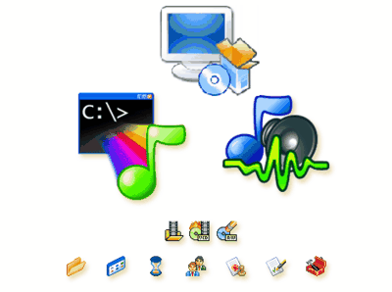
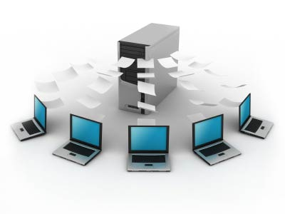
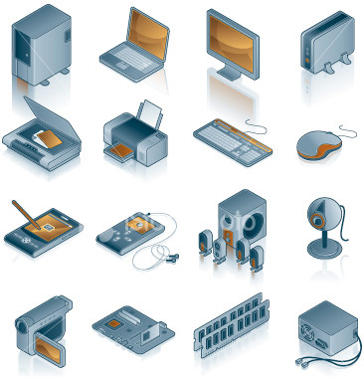
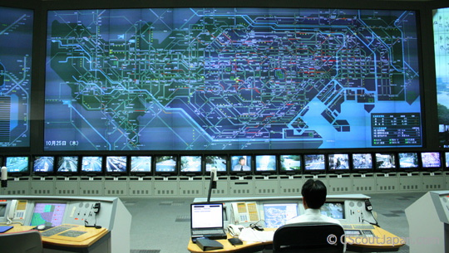
Elements of MIS
1.Hardware 2.Software
3.Control 4.Databases and application programs 5.People 6.Telecommunications and Networks

Slide 20
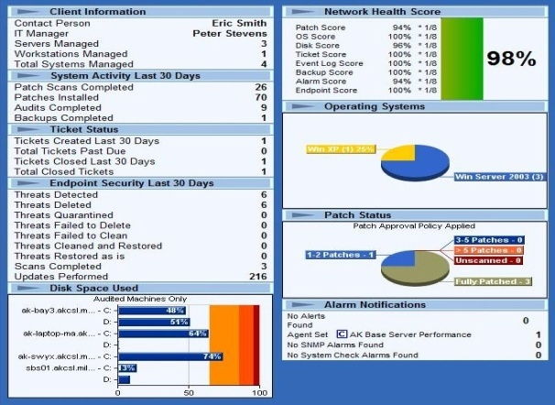
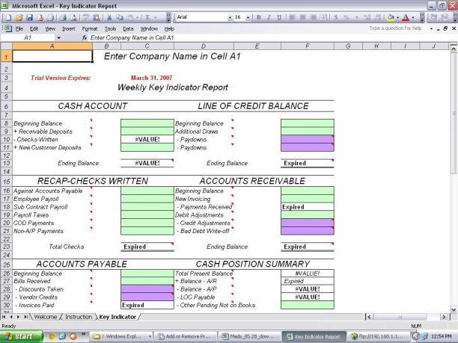
Outputs Of a MIS
Scheduled reports which are produced periodically, or on a Schedule (daily, weekly, monthly).
Key-indicator report which summarizes the previous day’s critical activities and also it is typically available at the beginning of each day.

Slide 21
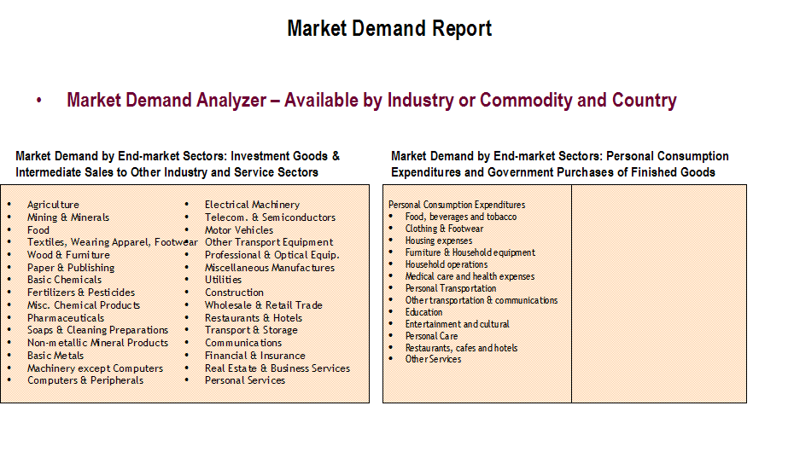
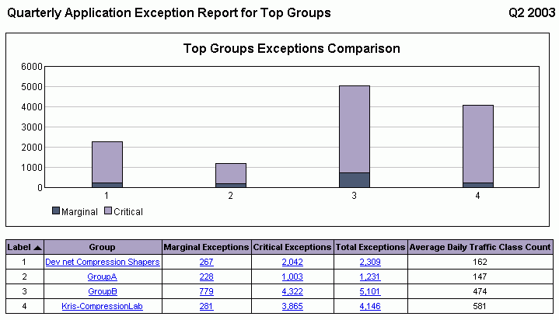
Outputs Of a MIS
Demand report which gives certain information at a manager’s request.
Exception report which is automatically produced when a situation is unusual or requires management action.

Slide 22

Benefits of MIS
It improves personal efficiency.
It expedites problem solving(speed up the progress of problems solving in an organization).
It facilitates interpersonal communication
It promotes learning or training.
It increases organizational control.

Slide 23
It generates new evidence in support of a decision.
It creates a competitive advantage over competition.
It encourages exploration and discovery on the part of the decision maker.
It reveals new approaches to thinking about the problem space.
It helps automate the Managerial processes.

Slide 24
Mobile Banking Management Information System Case Study
Company profile
This BI system was developed for one of the upcoming mobile banking operators in India with over a million registered users.

Slide 25
Situation
Before the deployment of the system, KPI reports were prepared using data from multiple Excel files.
There was a good amount of master data that was maintained manually and used along with system generated data to create the reports.
The entire process was carried out manually, which was both labour intensive and error prone.
The client required a reporting system that gets data from the mobile banking system on a daily basis in the form of flat files.
Moreover, there was a huge volume of records (upwards of 60 million) that needed to be processed on a daily basis.

Slide 26
Solution
XYZ assisted in creating an automated solution for report generation for the mobile banking system.
Developed complex ETL (Extraction Transformation Load) scripts to load existing data from various sources.
Created a dimensional model that is used by the reporting system.
Created a framework to handle the failures and re-runnable jobs on a daily basis.
Created a self-serve environment where users can login and run the reports.
Key reports are mailed on a daily basis to important stakeholders.
Summary reports are created on a monthly basis across regions and users.

Slide 27
Challenges
Huge amount of transactional data was being generated by the mobile banking server.
Multiple data sources with different data formats.
Complicated business rules with no documentation available.
Very short duration to build as fully functional system.
Daily data processing of upto 7 GB.
Multiple reports generated on a daily basis for different geographies and for different user roles and are persisted and maintained for a year.

Slide 28
Benefits
KPI Reporting of the mobile banking system done using the BI system built by XYZ.
No manual aggregation of multiple Excel files was required on a daily basis. Consequently, manual errors have been eliminated from the process as the application applies business rules uniformly across all data sources.
Data, which was earlier only in disparate excel sheets, is now collated in a single source and is available for running reports.
The system processes over 60 million records on a daily basis.
Notifications and audit checks in place which will intimate about the health of the system

Slide 29
Products and services used
Framework: MS BI
Database: MS SQL Server
Source: Excel files and flat file data

